Slide 1


Block-level Elements
A block-level element always starts on a new line, and the browsers automatically add some space (a margin) before and after the element.

Slide 2




Slide 3


Slide 4
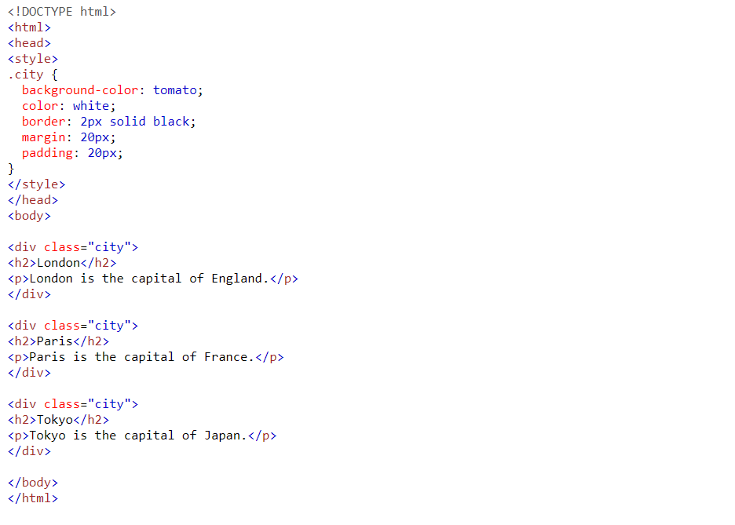
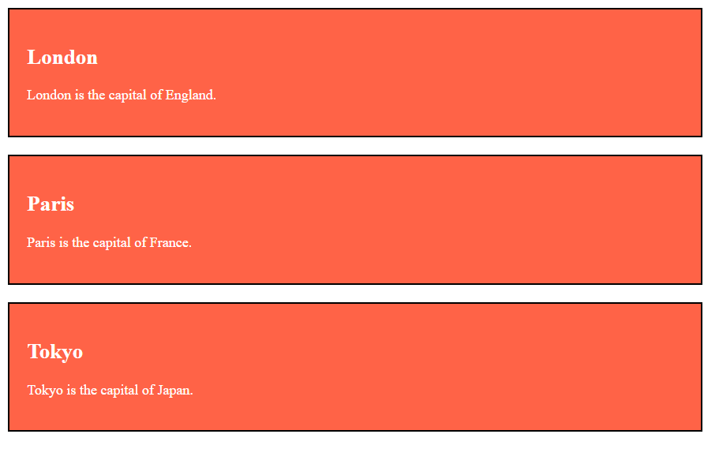

Slide 5
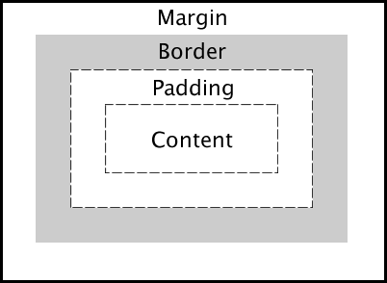
Margin padding
In CSS, a margin is the space around an element's border, while padding is the space between an element's border and the element's content.

